Slide 1
MAST (Tech Support)
Mobilized Assistance Supporting Translation
By:
Parfait AYANOU and John WOOD
[Wycliffe Associates’ Tech Advance]

Slide 2
TOPICS
INTRODUCTION (MAST)
Tablets and the Laptops
Hardware Maintenance
TABLET
LAPTOP
ts-Studio
Andriod
Desktop
Using the application (Slides)

Slide 3
INTRODUCTION
Our breakthrough MAST strategy (Mobilized Assistance Supporting Translation) is a collaborative, church-based, rapid translation method. MAST allows us to come alongside and assist the local church and national translators.
Wycliffe Associates’ Tablets for National Translators (TNTs) program is making an extraordinary impact. This brand-new, high-tech tool helps believers hide Scripture translation efforts in plain sight.

Slide 4
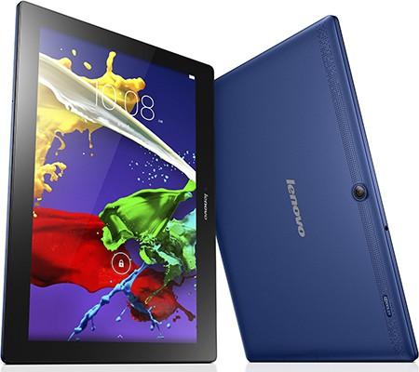
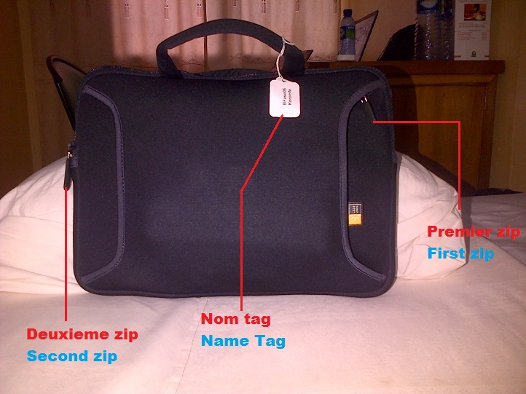
Tablets / Laptops
Tablets and laptops are the tools that we use in making our translation work easier.

Slide 5
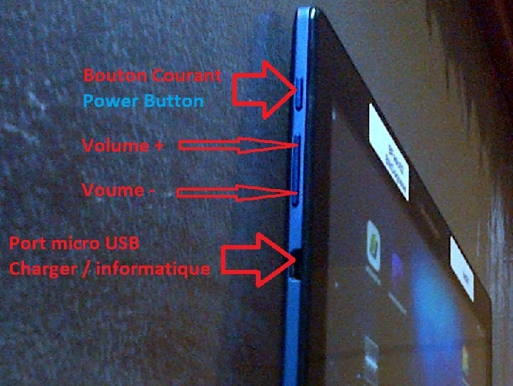
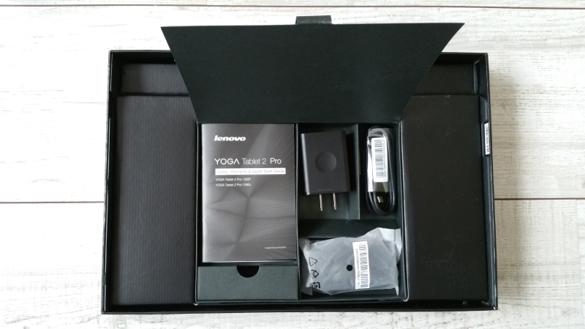
Tablet

Slide 6
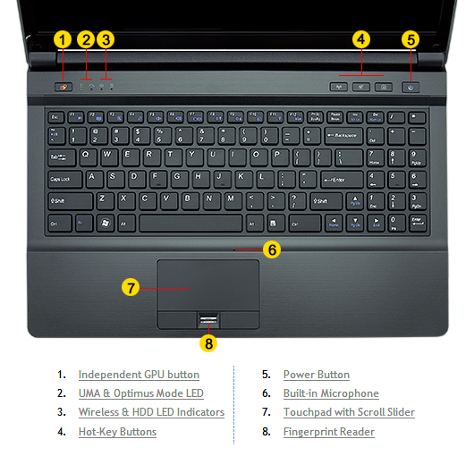
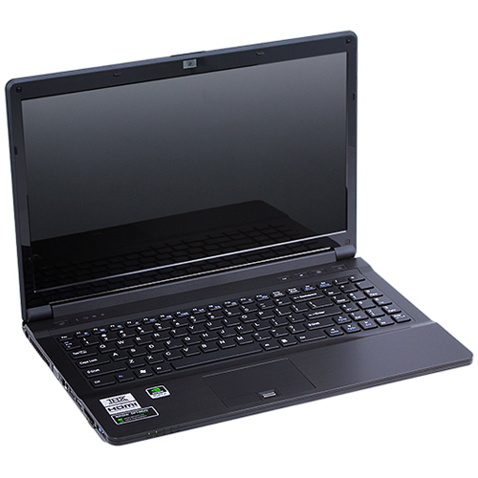
LAPTOP

Slide 7
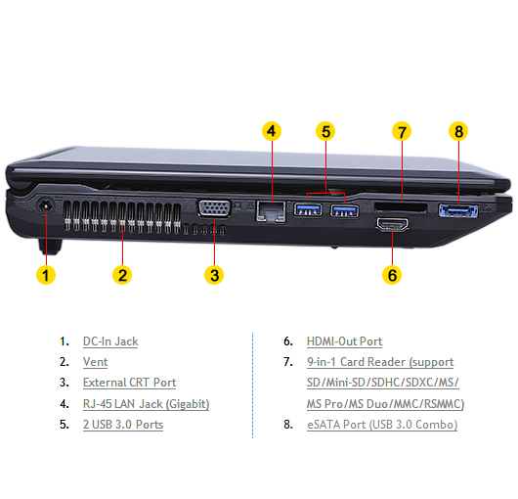
LAPTOP

Slide 8
MAINTENANCE /TABLETS
Always use a microfiber cloth to clean the screen.
Never clean the touchscreen by using a liquid — especially ammonia or alcohol. Those substances damage the touchscreen, rendering it unable to read your input. Further, such harsh chemicals can smudge the display, making it more difficult to see.
If the screen keeps getting dirty, consider adding a screen protector. This specially designed cover prevents the screen from getting scratched or dirty while also letting you use your finger on the touchscreen. Be sure that the screen protector is designed for use with your model Samsung Galaxy tablet.
NEVER load movies, pictures or music because that will reduce the speed of your device and also fill in all the storage space on the tablet.

Slide 9
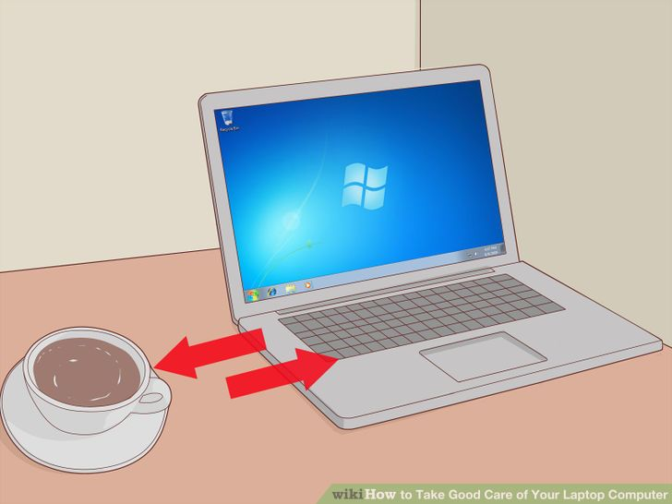
MAINTENANCE/LAPTOP
How to Take Good Care of Your Laptop Computer
It is important that you take good care of your laptop to keep it working well. Following these easy steps will ensure that your laptop lasts longer and requires less maintenance. As an added bonus, many of the steps will also maintain your laptop's speed. It is also useful to do a check of the laptop once in a while so as to remove any errors or problems which might have crept in during the routine usage.
1
Keep liquids away from your laptop. As tempting as it might be to drink coffee, soda, water or any other liquid near your laptop, accidents can happen all too easily. Alternatively, use a cup with a cover on it, so even if it does spill, the liquid doesn't go anywhere. Spilled liquids may damage the internal microelectronic components or cause electrical damage. Short circuits can corrupt data or even permanently destroy some parts of the laptop. The solution is very simple: Keep your drinks away from your computer. Even if you are careful, someone else might spill your drink.

Slide 10
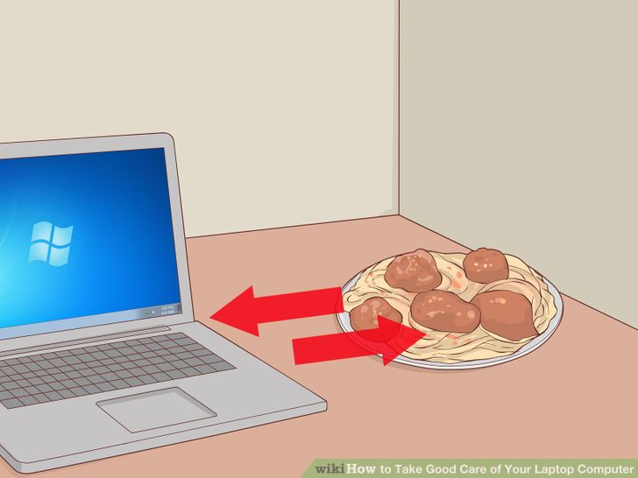
MAINTENANCE/LAPTOP
2
Having antivirus software available is the best defence against a virus. Even if you know what you download, it could still contain a virus. If you choose not to have antivirus software you run the risk of a circuit error or software problem in your system. The virus may also slow down the system operations and performance.
3
Keep food away from your laptop. Don't eat over your laptop, the crumbs can fall between the keys and provide an invitation to small bugs or damage the circuitry. Worse yet, the laptop will look dirty if there are crumbs on it.

Slide 11
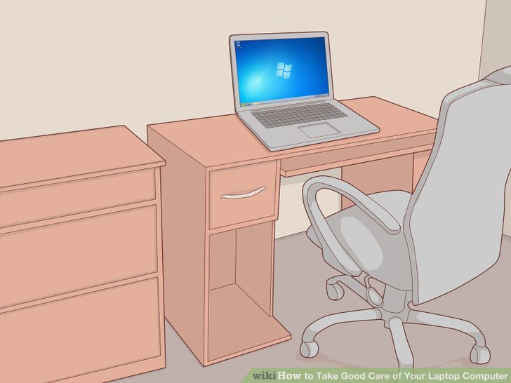
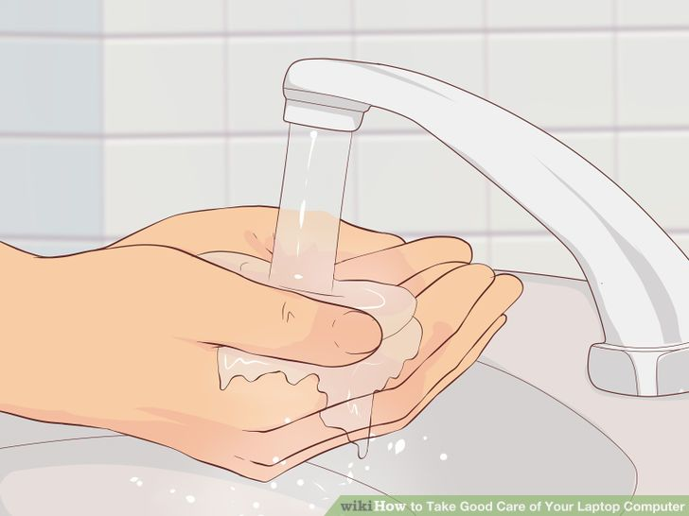
MAINTENANCE/LAPTOP
4
Ideally keep the computer in a clean and dust free room.
5
Always have clean hands when using your laptop. Clean hands make it easier to use your laptop touchpad and there will be less risk of leaving dirt and other stains on the computer. In addition, if you clean your hands before you use the laptop, you will reduce wear and tear on the coating caused by contact with sweat and small particles that can act upon the laptop's exterior.

Slide 12
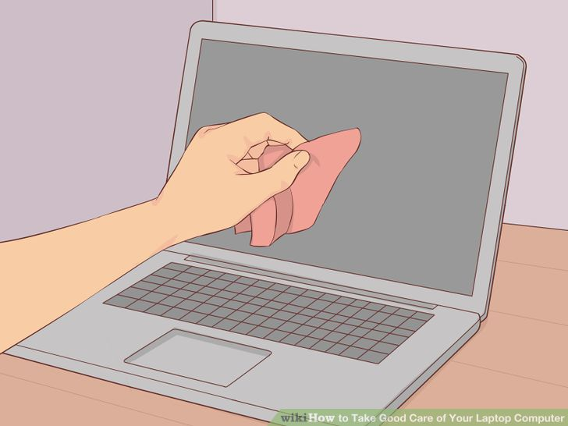
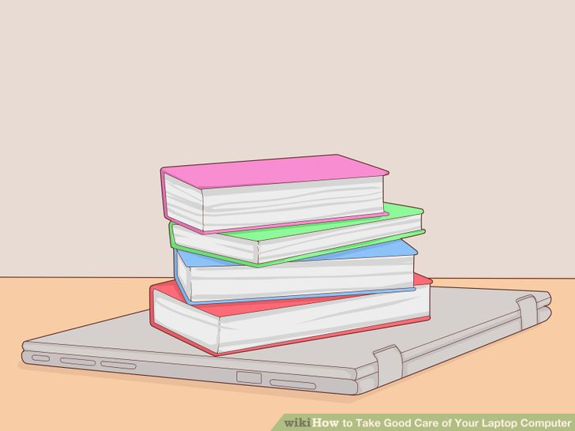
MAINTENANCE/LAPTOP
6
Be sure to plug accessory devices into their proper slots. Always look at the symbols on the laptop carefully before inserting devices. Jamming a phone line into an Ethernet port or vice versa could damage the sockets, making it impossible to use them again. It is very important to observe this step.
7
Have the unit cleaned annually to remove internal dust. Get this done by a computer professional, or do it yourself if you can. If dust accumulates, the system will not be able to cool itself correctly. Heat can destroy the motherboard.
8
Avoid placing heavy materials, such as books, on top of your laptop. This can push the LCD screen into the keyboard, and will eventually damage it. Also, the CD-ROM insert will be squished and, eventually, will break.

Slide 13
TRANSLATION STUDIO
translationStudio
translationStudio (tS) is a free utility for translating the Bible and biblical content into any language. The purpose of translationStudio is to make Bible translation accessible to the global church. translationStudio is fully functional without an internet connection and enables collaboration in the translation process. The app includes numerous just in time translation helps that explain keywords, difficult to translate phrases, and general translation concepts. When translations are completed, the app enables uploading and publishing through the unfoldingWord platform.

Slide 14
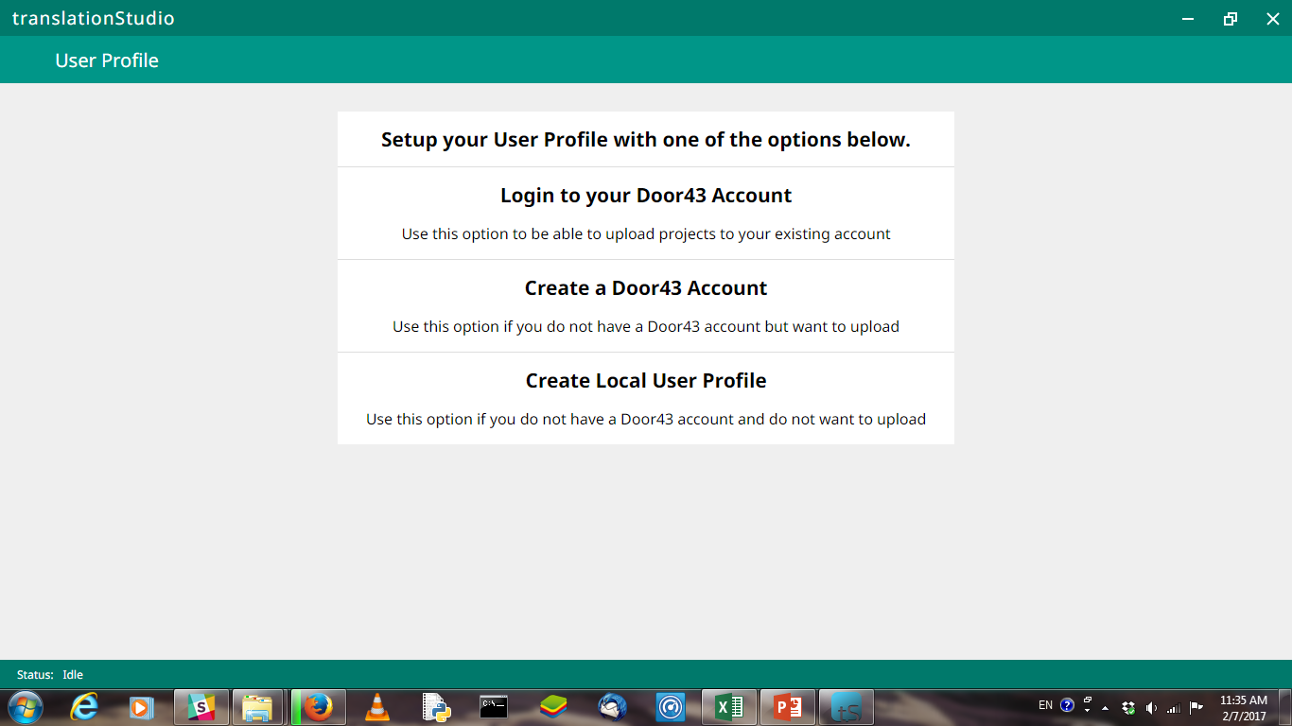
Login page

Slide 15
Start a new project

Slide 16
New Project
Language Code

Slide 17
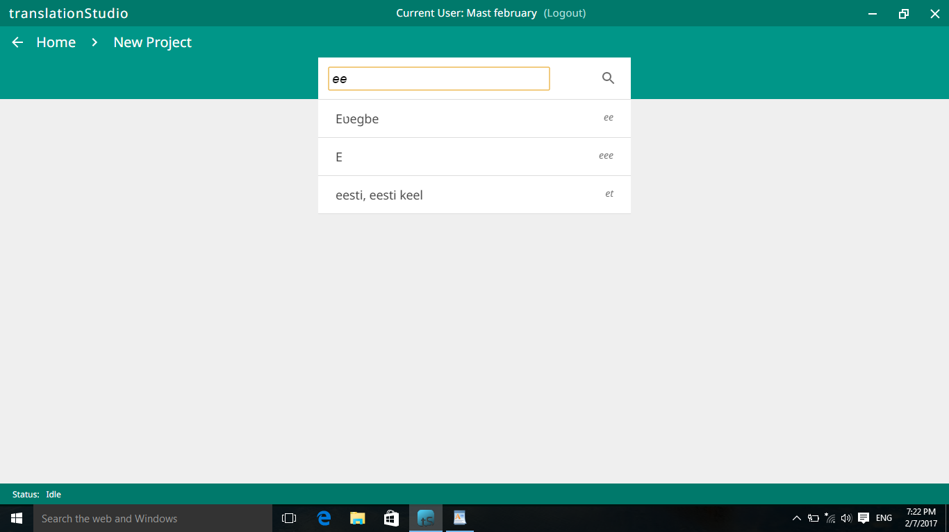
Enter the Language code
TARGET LANGUAGE

Slide 18
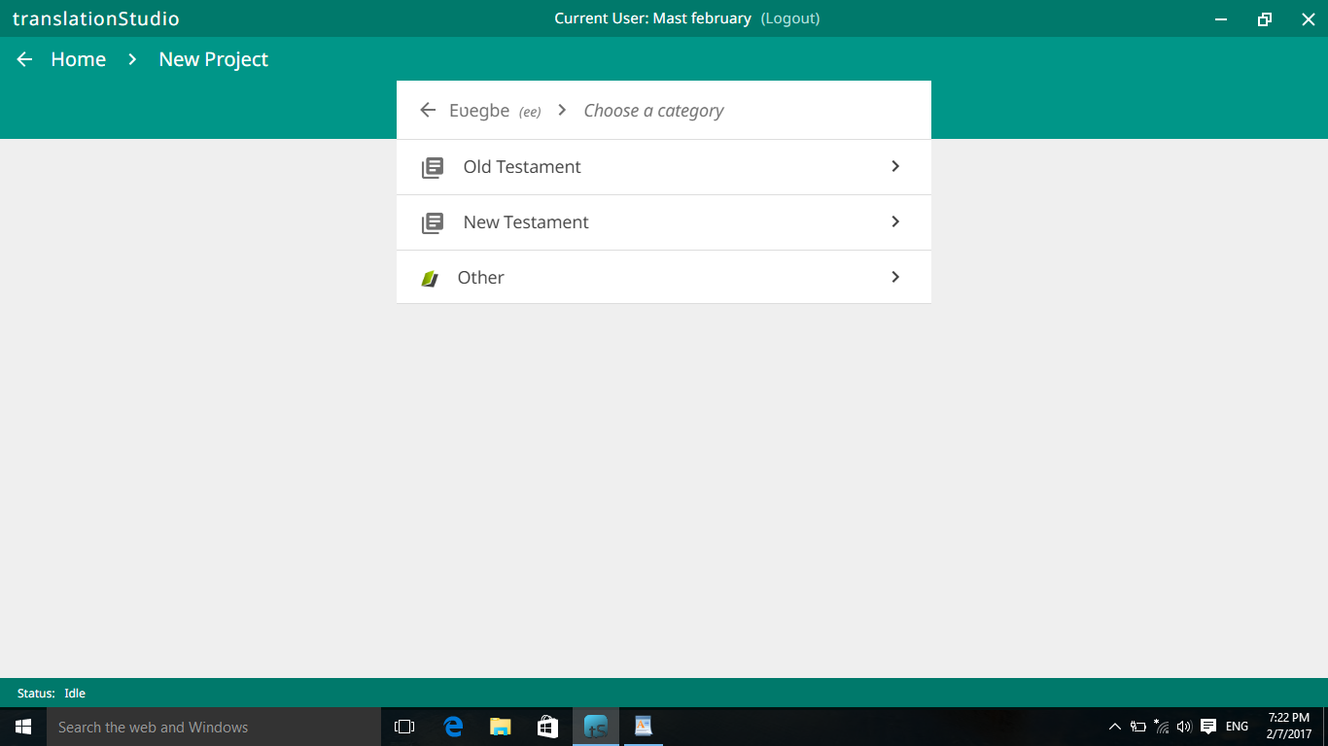
Project (New/Old Testament/Other)

Slide 19
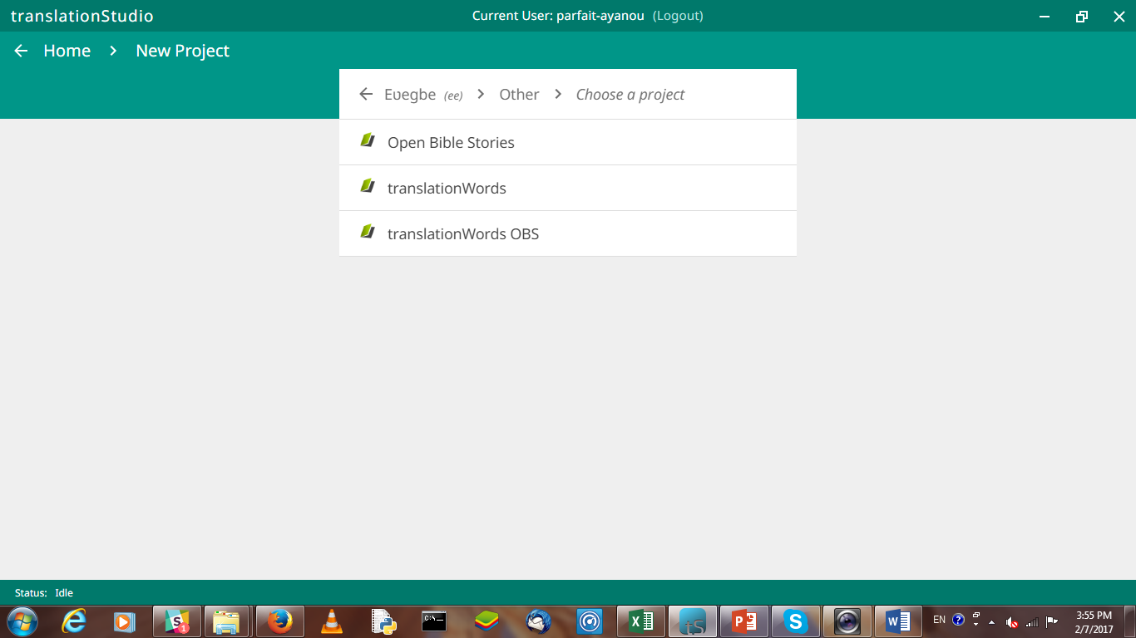
Project Category / Other

Slide 20
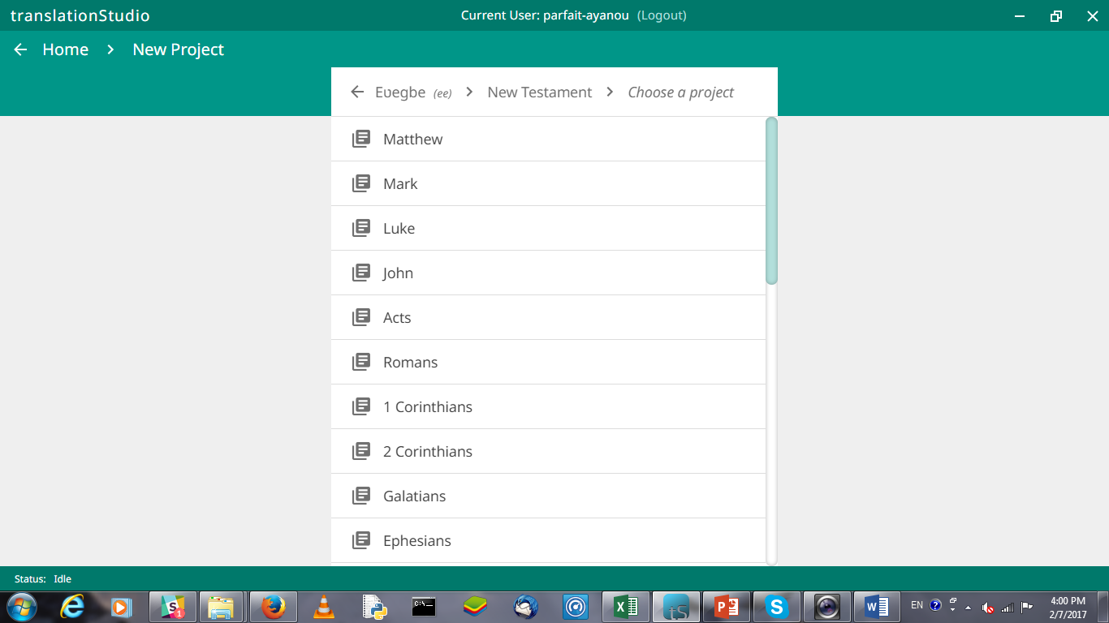
Project Category/ New Testament
Choose a book

Slide 21
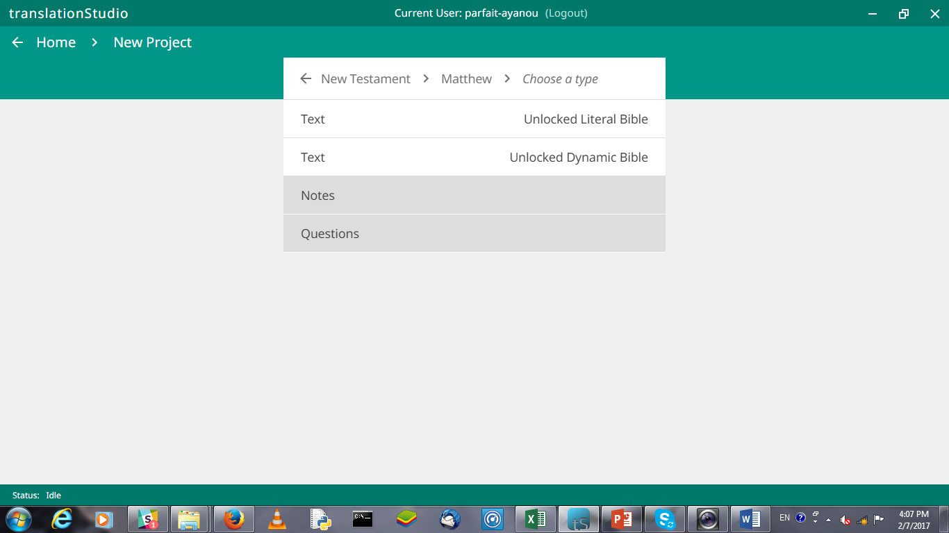
Choose a type of Text Source
ULB Text Source
UDB Text Source
Translation Notes Project
Translation Questions Project

Slide 22
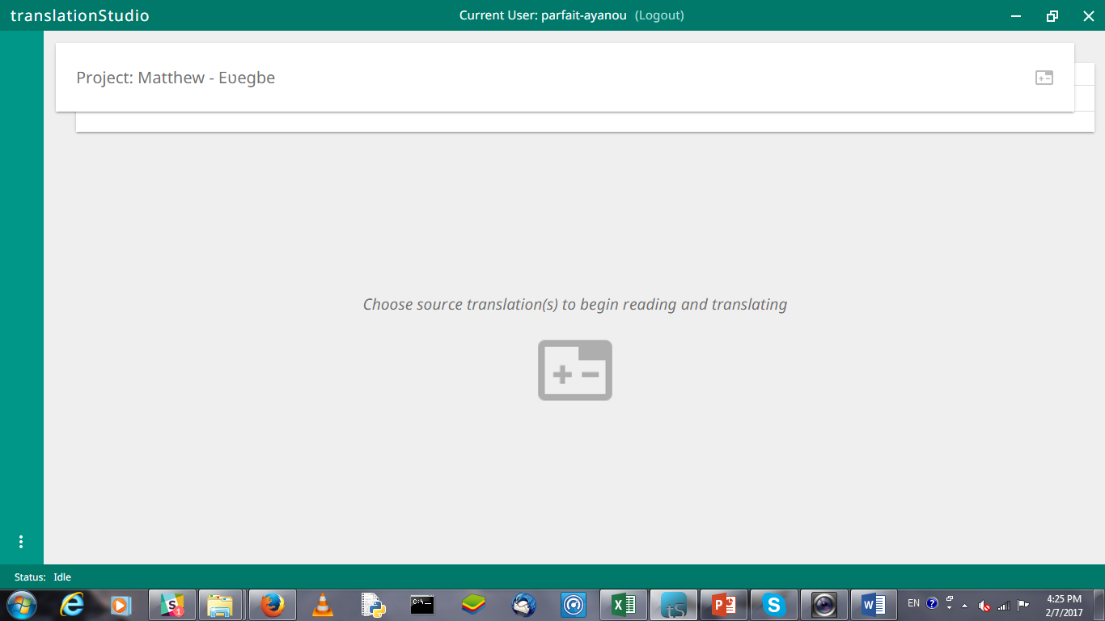
Choose Source

Slide 23
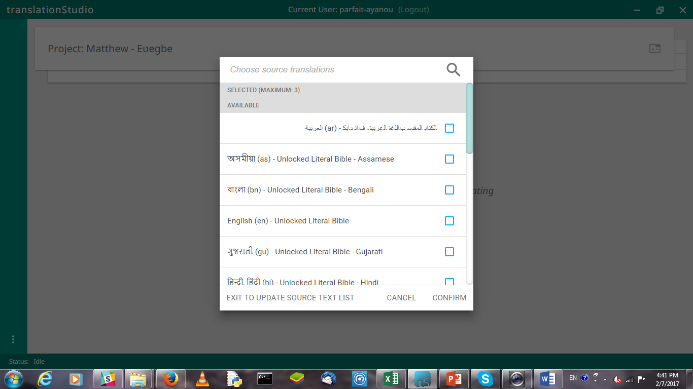
Choose Source

Slide 24
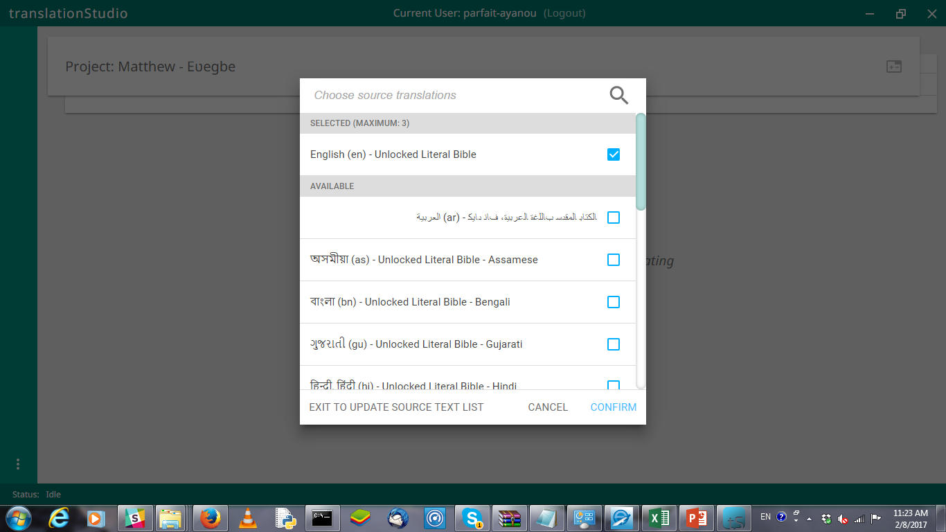
Choose Source Translations

Slide 25
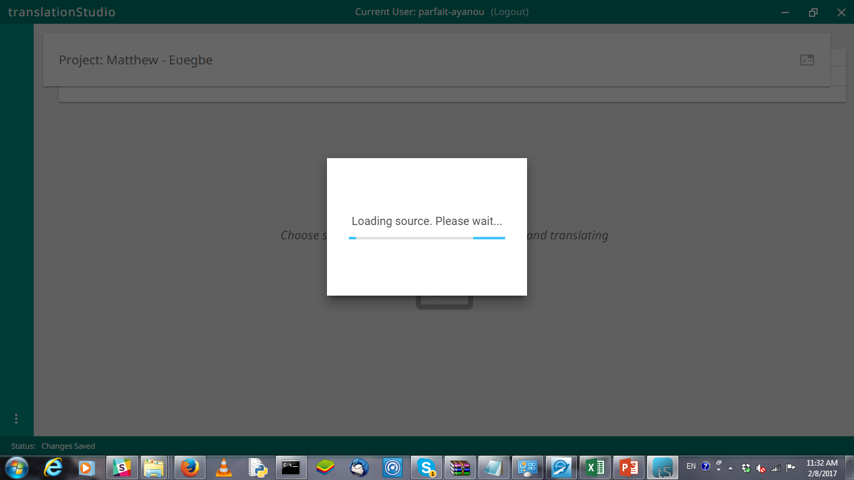
Loading

Slide 26
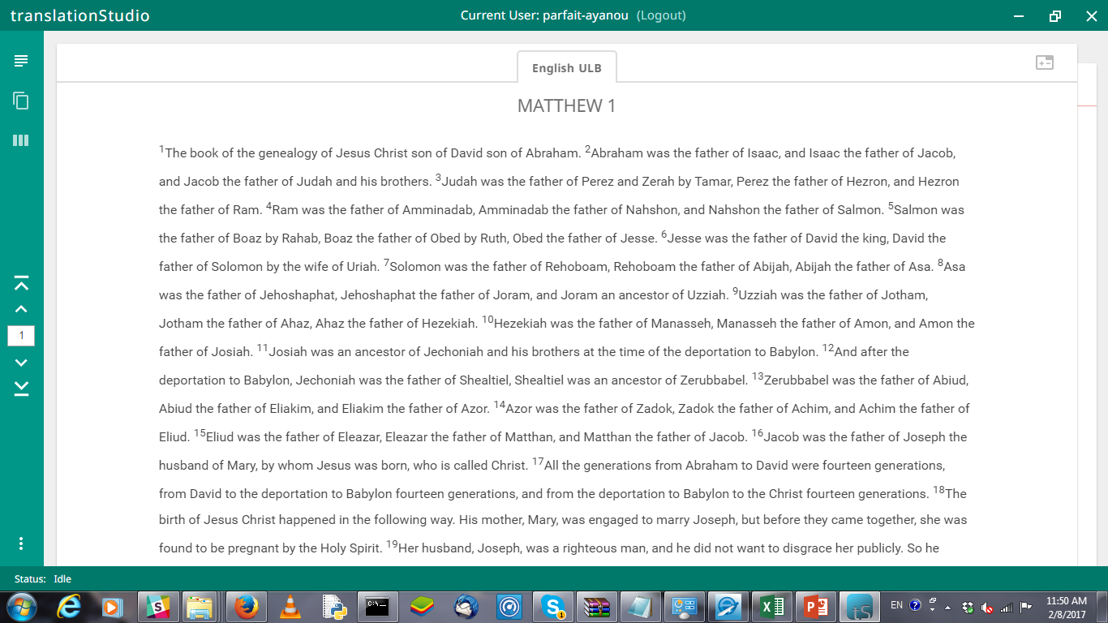
Read Mode
Go to the Beginning of the book
Go to the End of the book

Slide 27
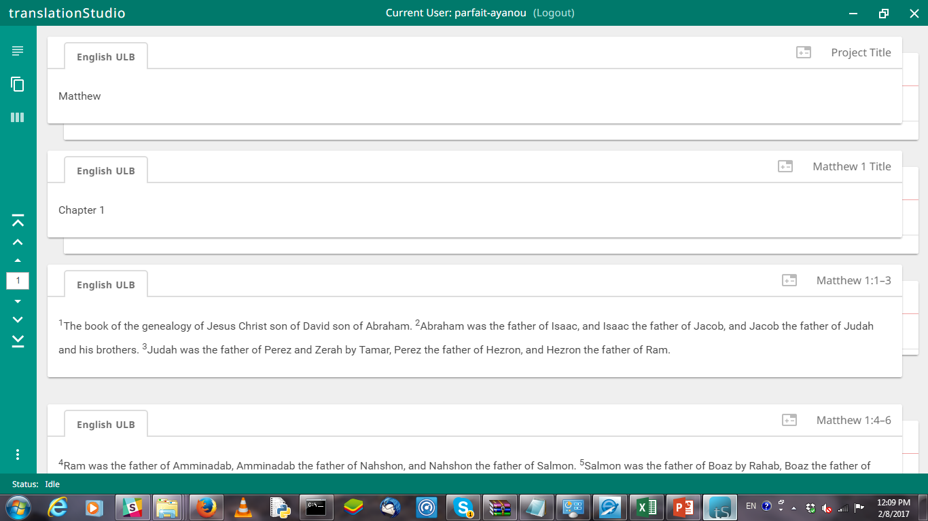
Chunk Mode
Chunk Mode
Go to beginning of the Previous Chapter
Go to the Previous Chunk
Go to the Next Chunk
Go to beginning of the Next Chapter

Slide 28
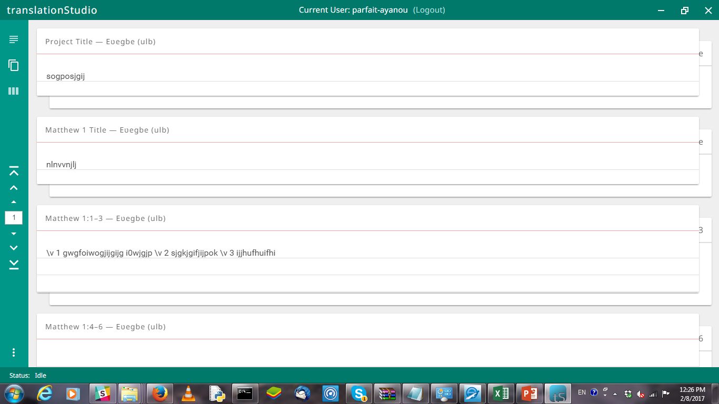
Chunk Mode/Blind draft Mode
Chapter number

Slide 29
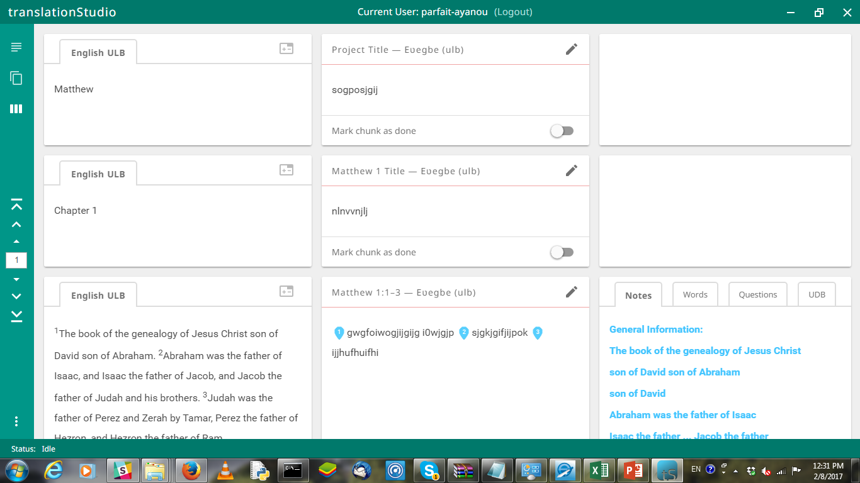
Review Mode
Review Mode
Edit

Slide 30
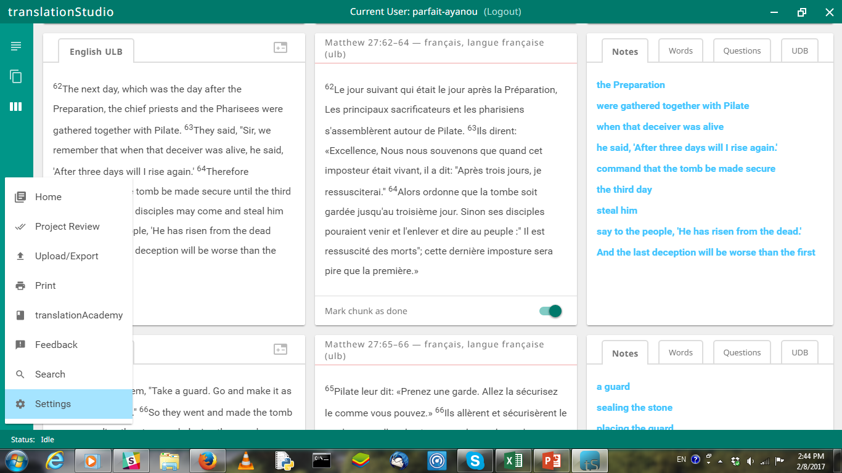
Ts Menu

Slide 31
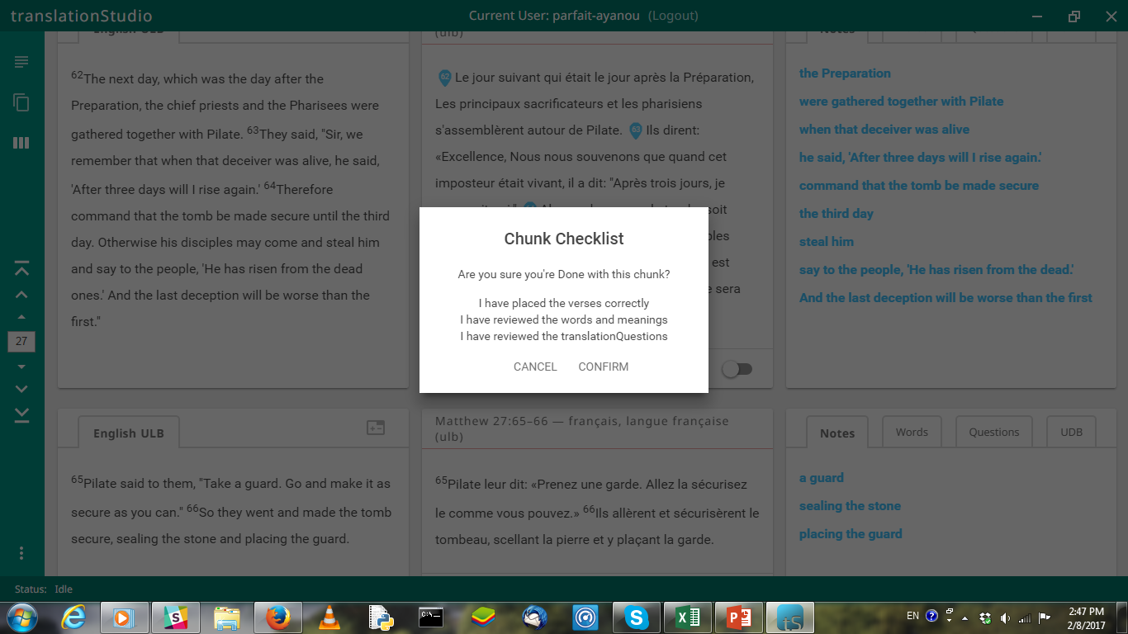
Chunk Checklist

Slide 32
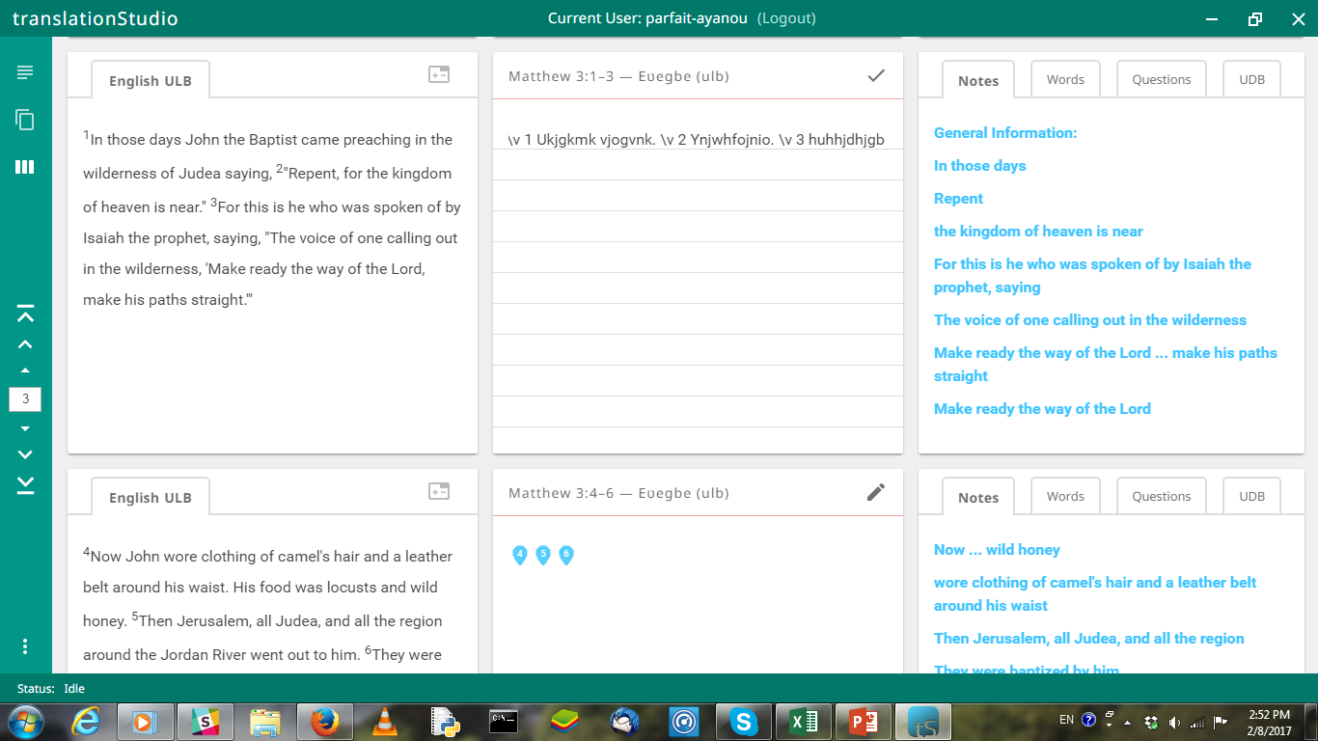
Verse Markers

Slide 33
Tech Support Section: Back up/Printing

Slide 34
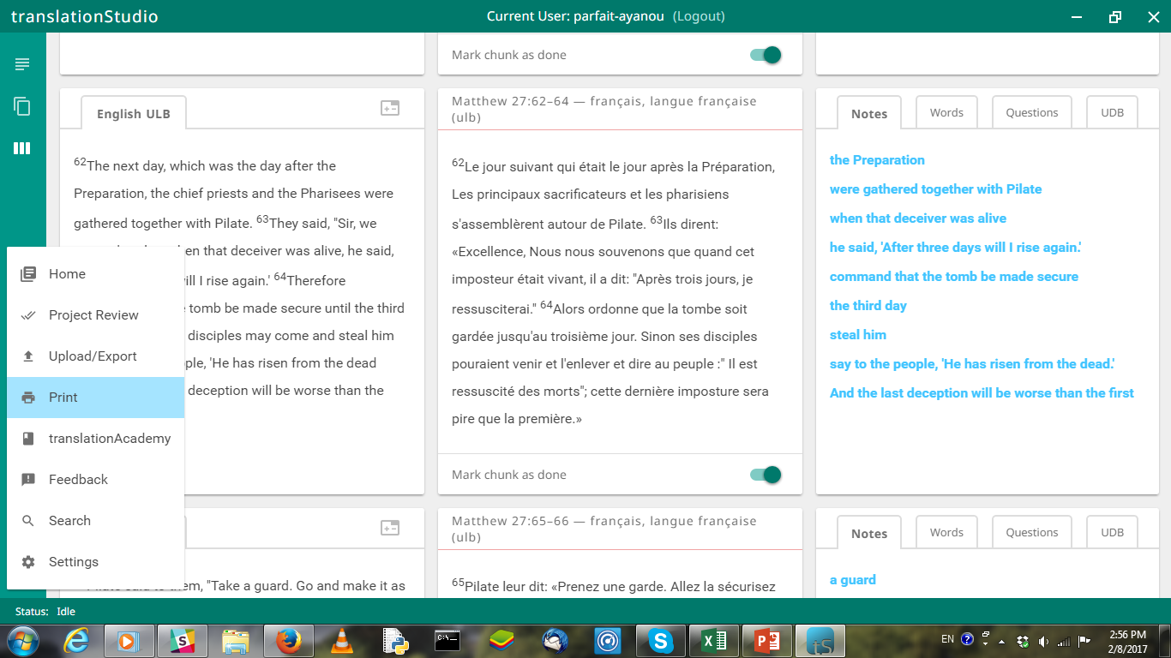
Printing
Make sure project is opened

Slide 35
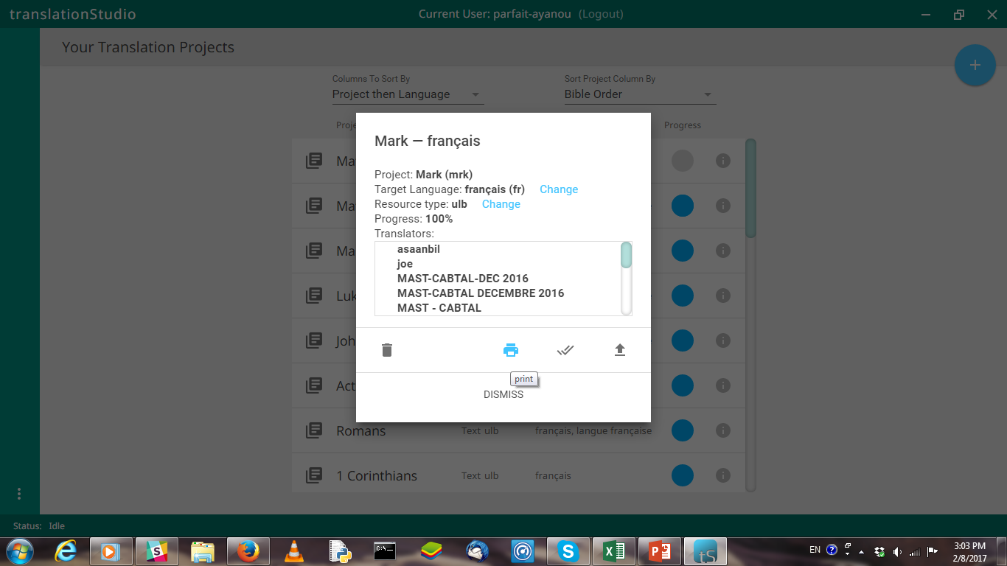
Printing

Slide 36
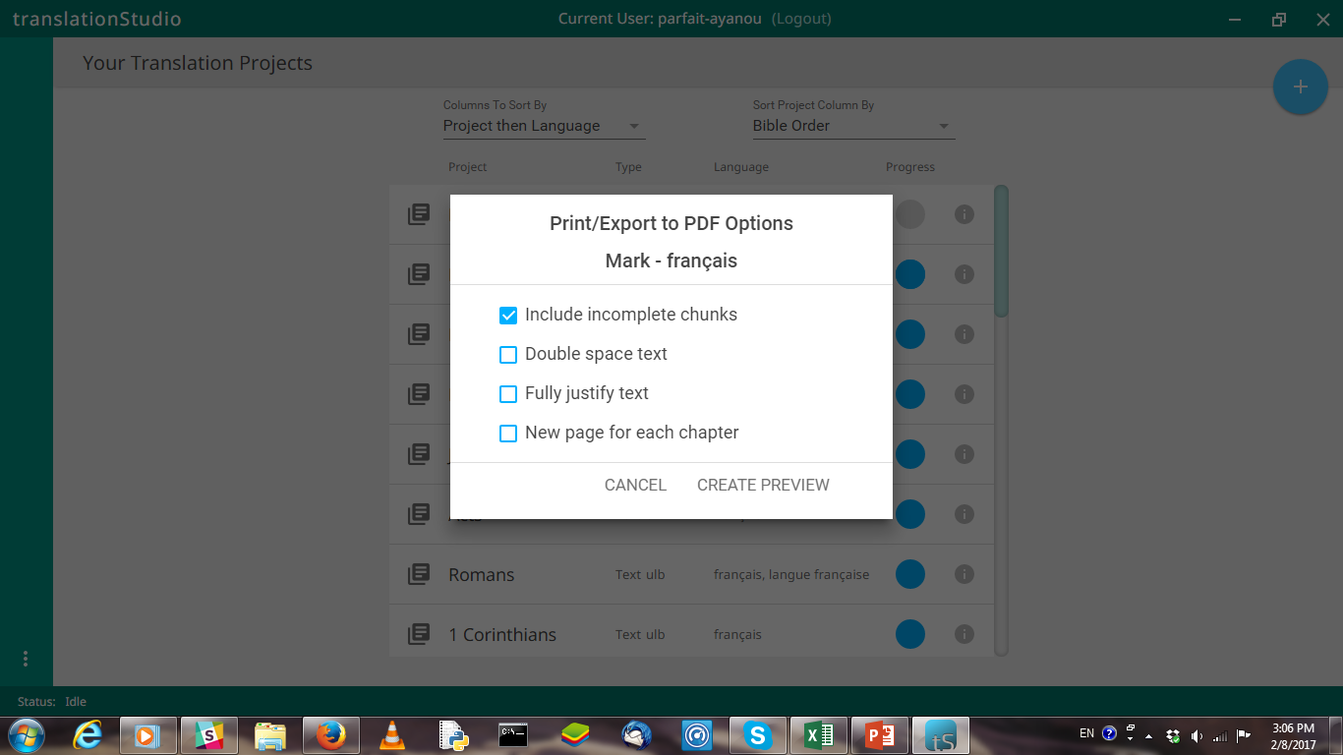
Printing

Slide 37
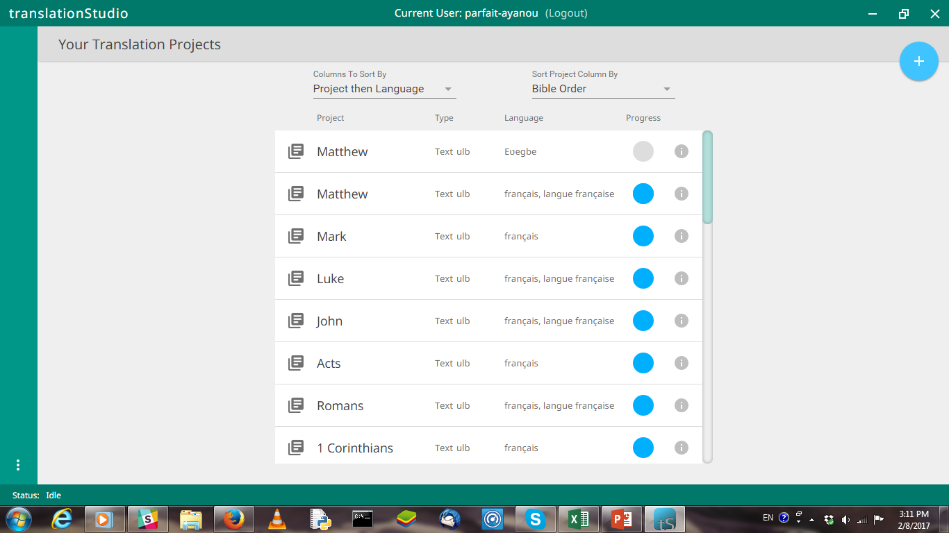
Back up

Slide 38
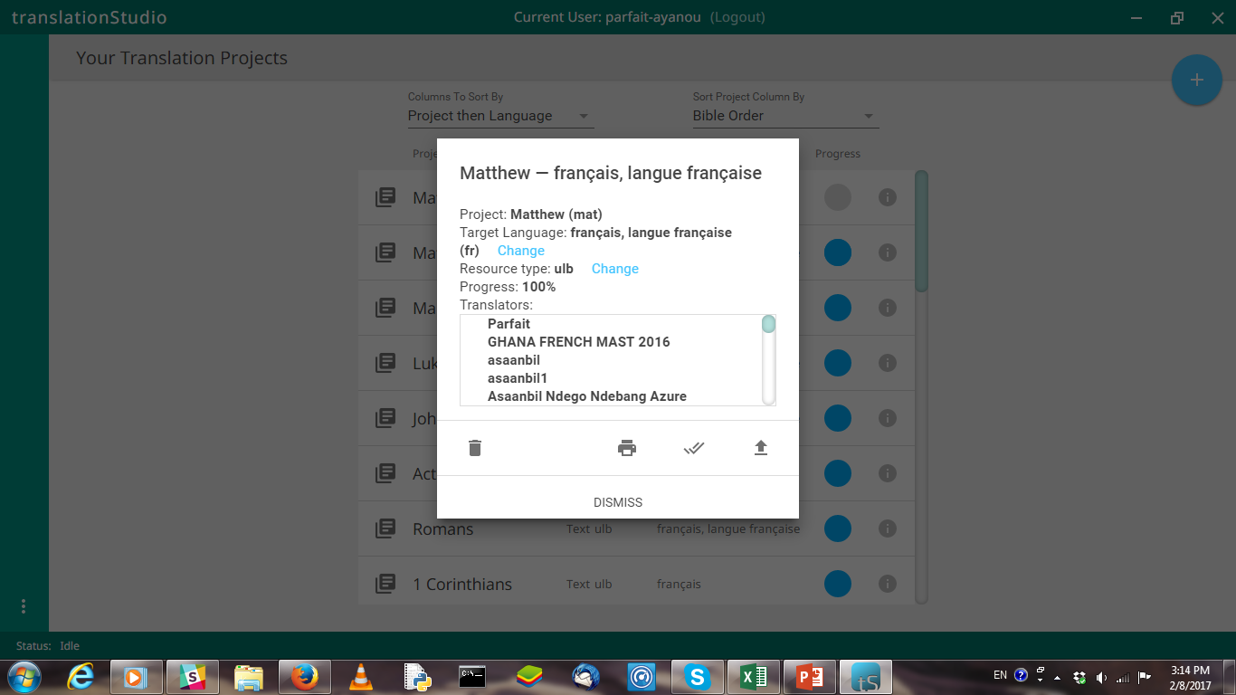
Back up

Slide 39
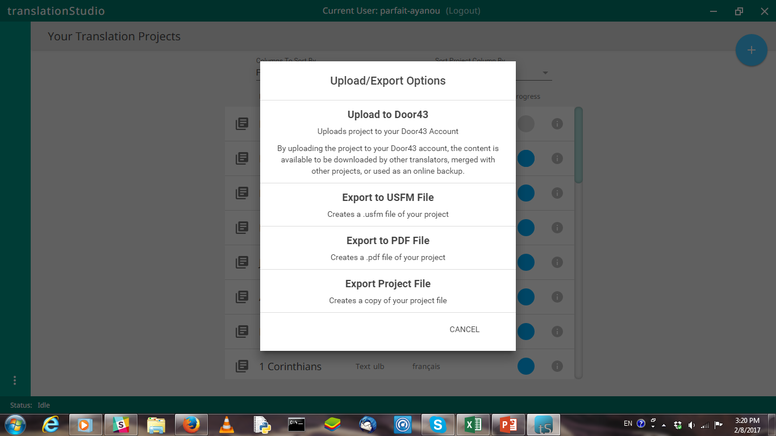
Back up

Slide 40
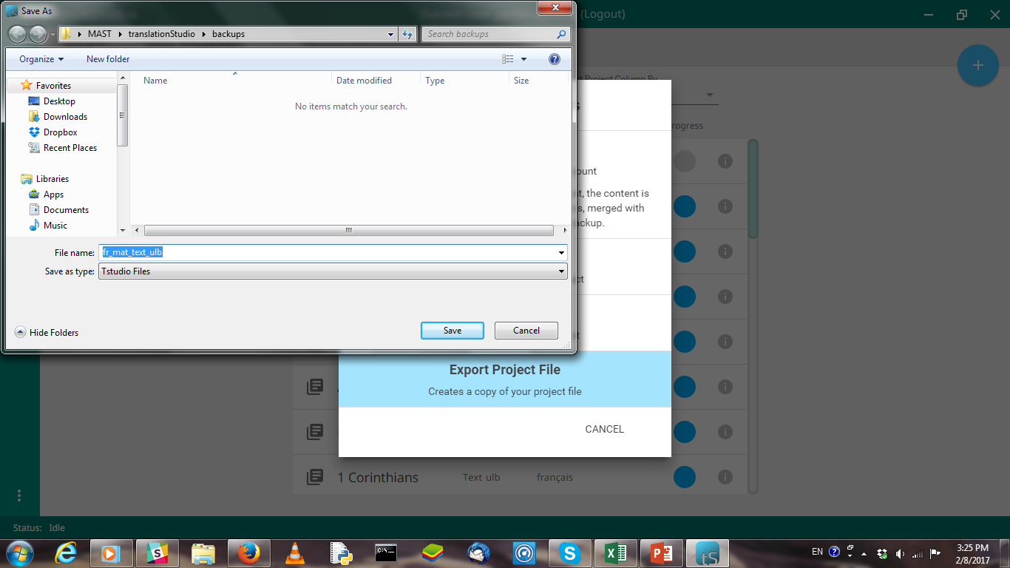
Back up

Slide 41
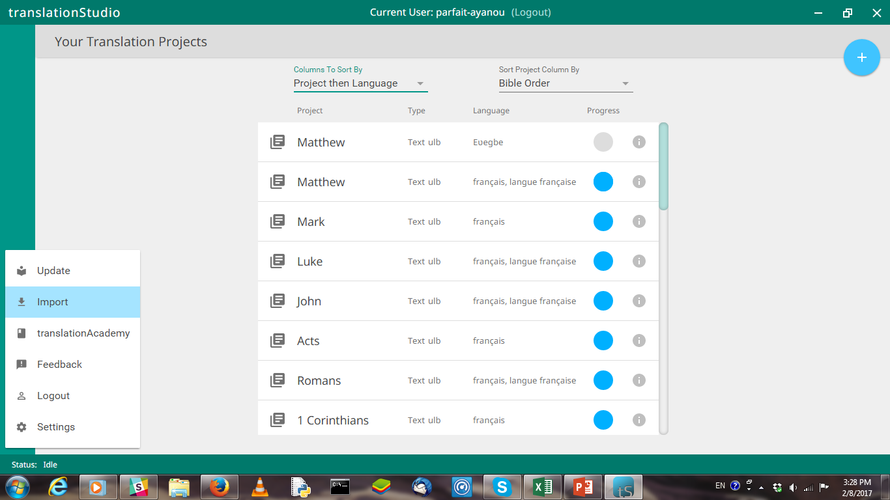
Import a Project

Slide 42
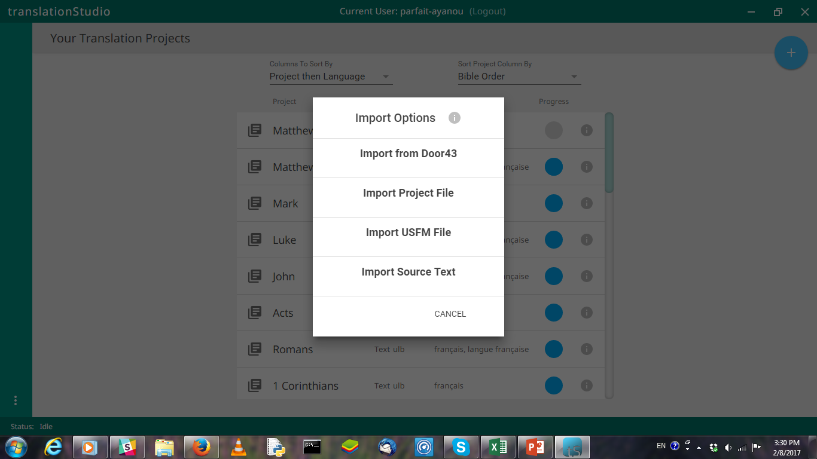
Import a Project

Slide 43
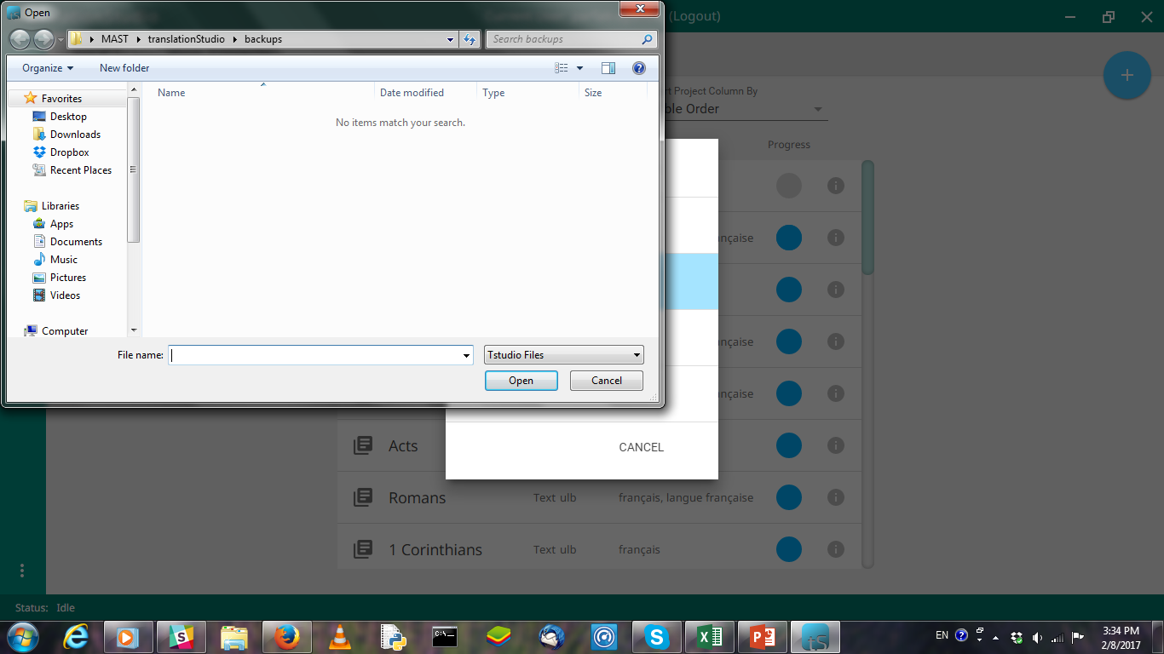
Import a Project

Slide 44
Importing

Slide 45
Import

Slide 46
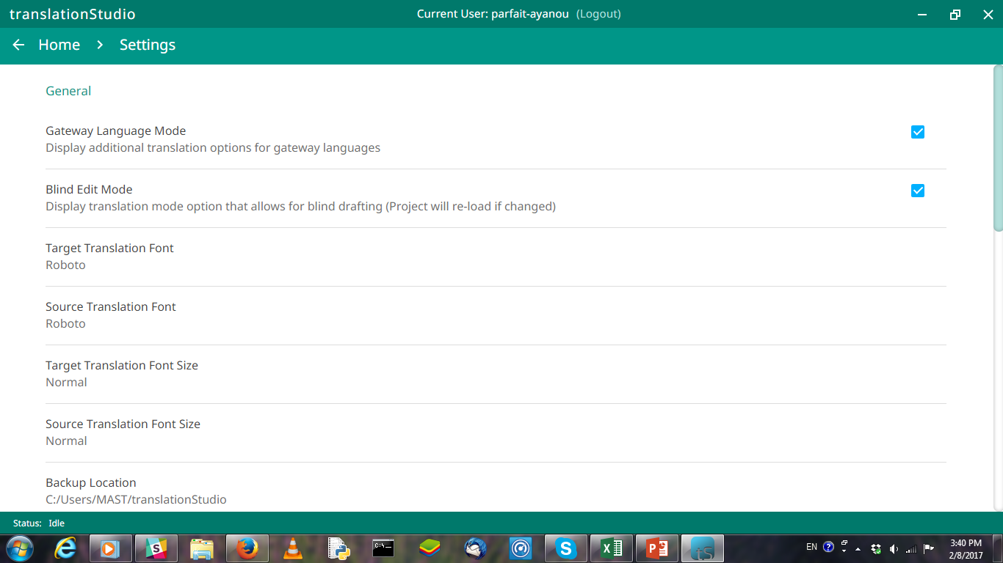
Settings

